Slide 1
IO STREAM IN JAVA
Dr Ilayaraja N

Slide 2
What is File I/O?
Java I/O stream is the flow of data that you can either read from, or you can write to.
It is used to perform read and write operations in file permanently.
Java uses streams to perform these tasks.
Java I/O stream is also called File Handling, or File I/O.
It is available in java.io package.

Slide 3
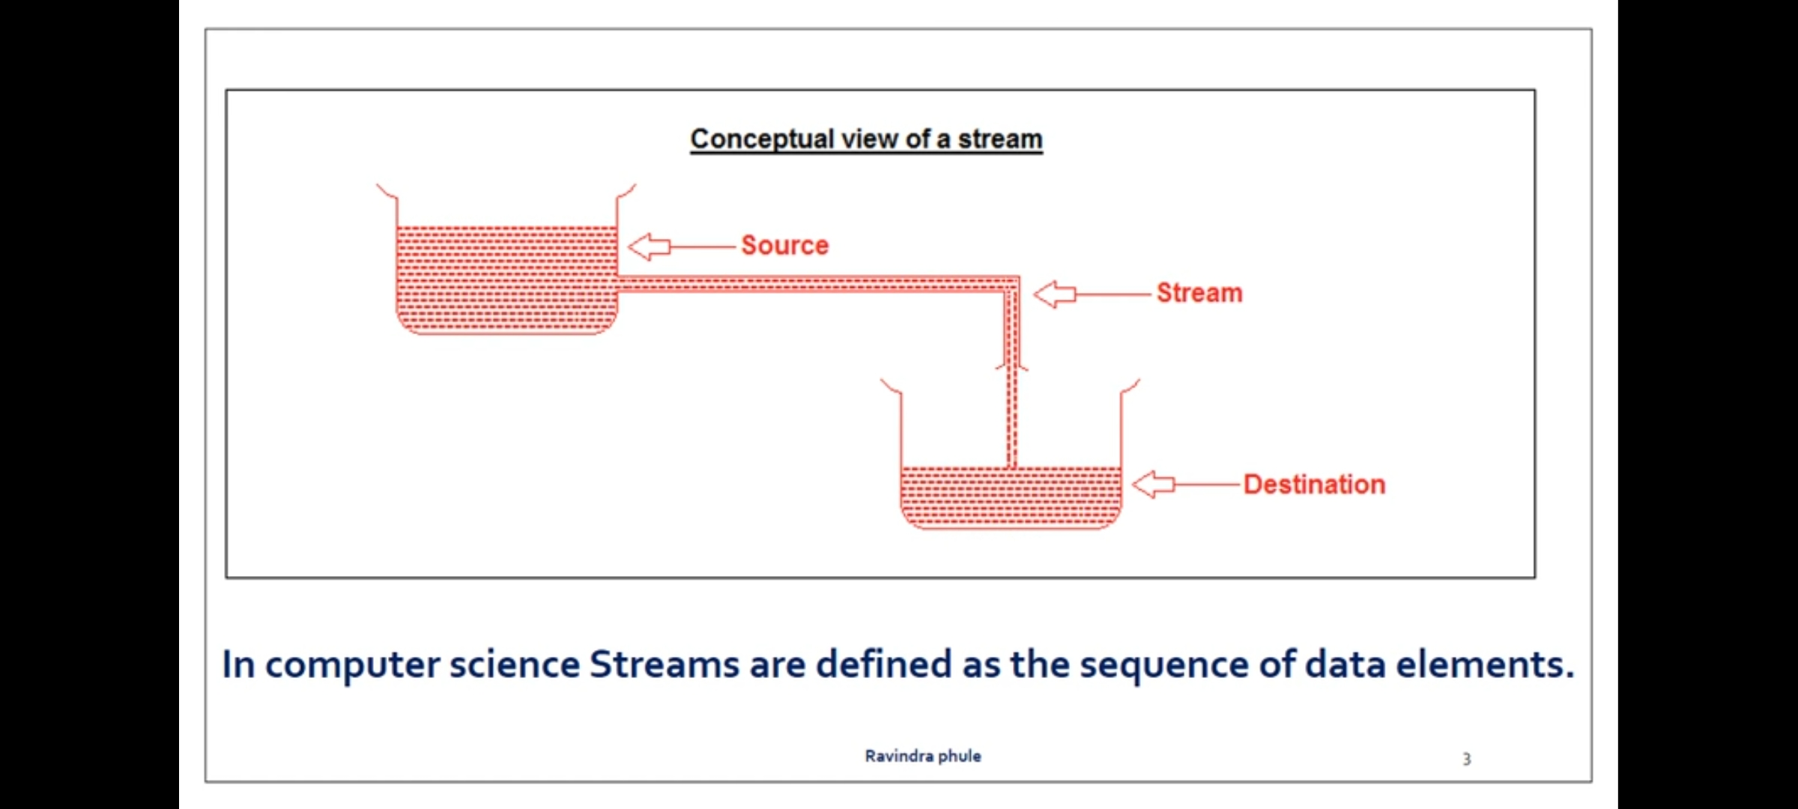
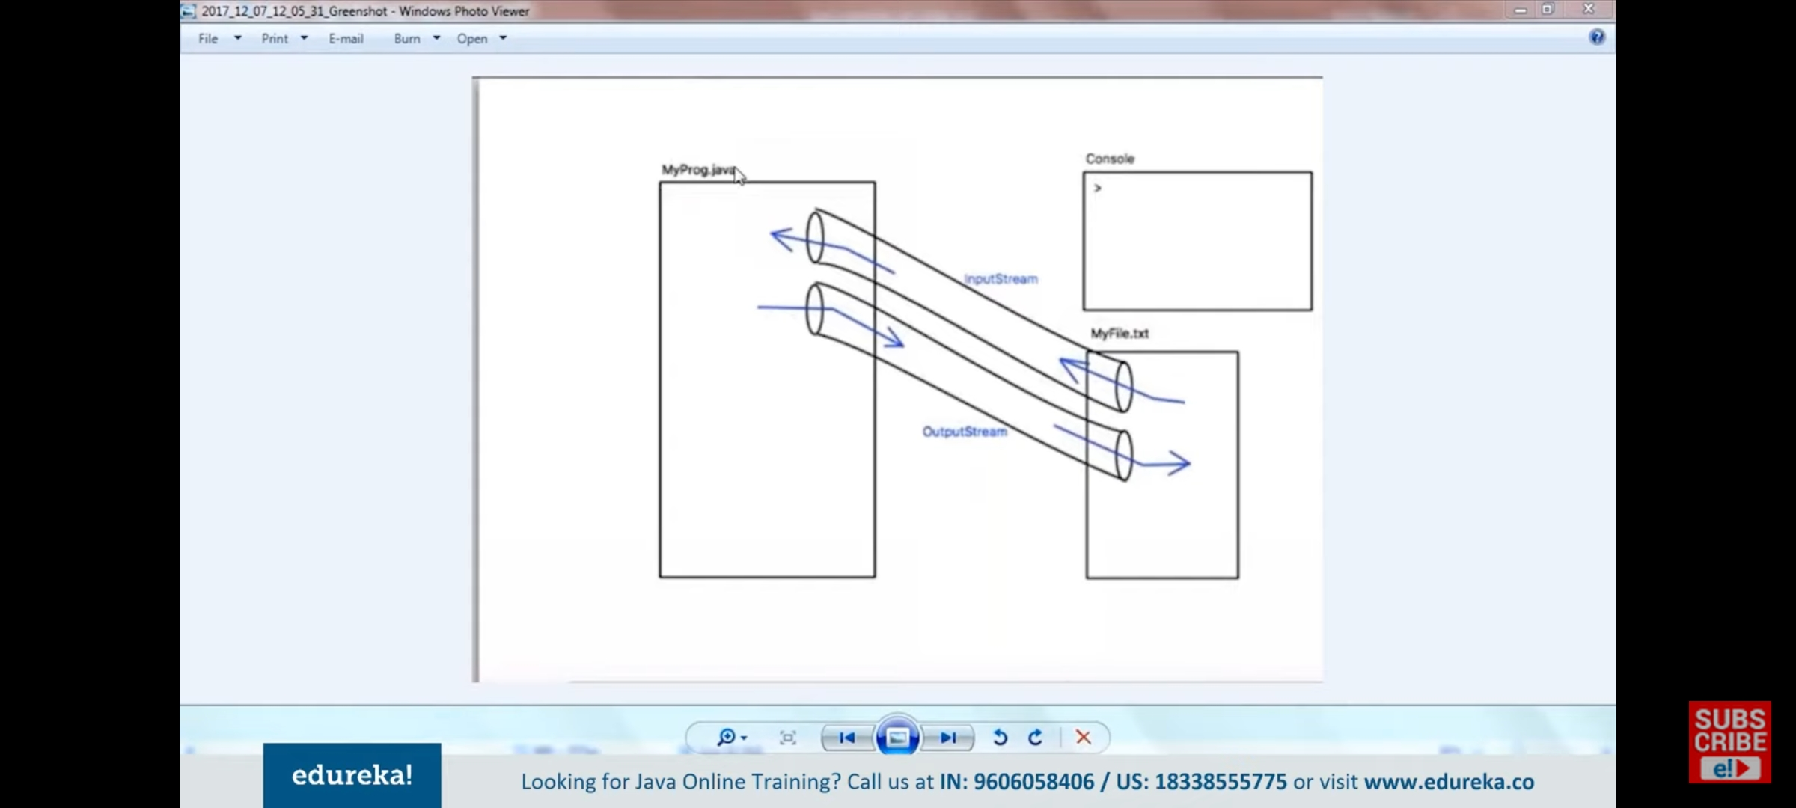
Stream

Slide 4
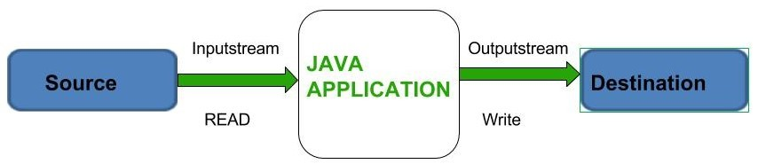
Stream

Slide 5
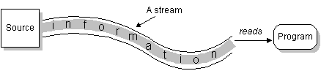
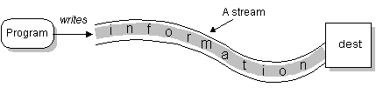
Stream
“A stream can be defined as a sequence of data”
InPutStream − The InputStream is used to read data from a source.
“a program opens a stream on an information source (a file, memory, a socket) and reads the information sequentially”
OutPutStream − The OutputStream is used for writing data to a destination.
“a program can send information to an external destination by opening a stream to a destination and writing the information out sequentially”

Slide 6
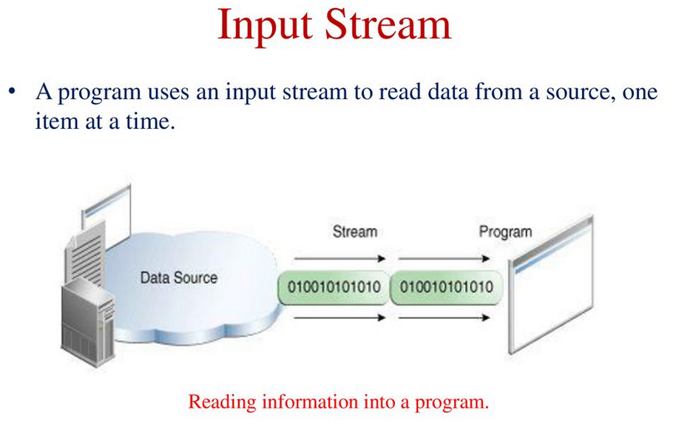

Slide 7
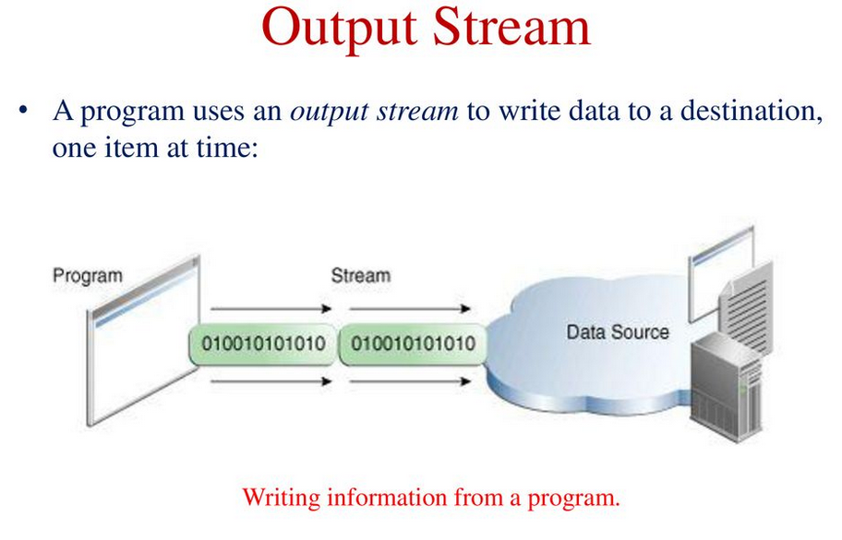

Slide 8
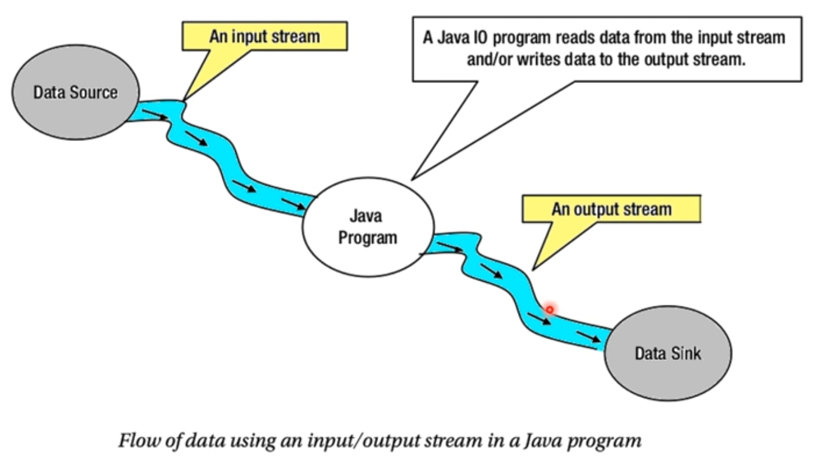
Stream

Slide 9
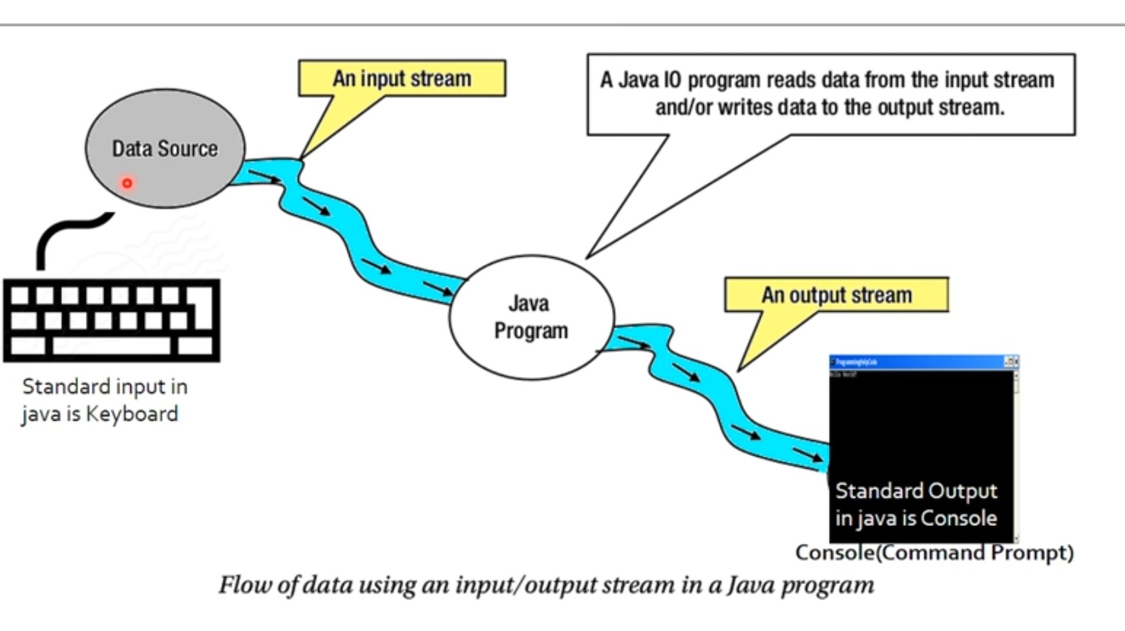
Stream

Slide 10
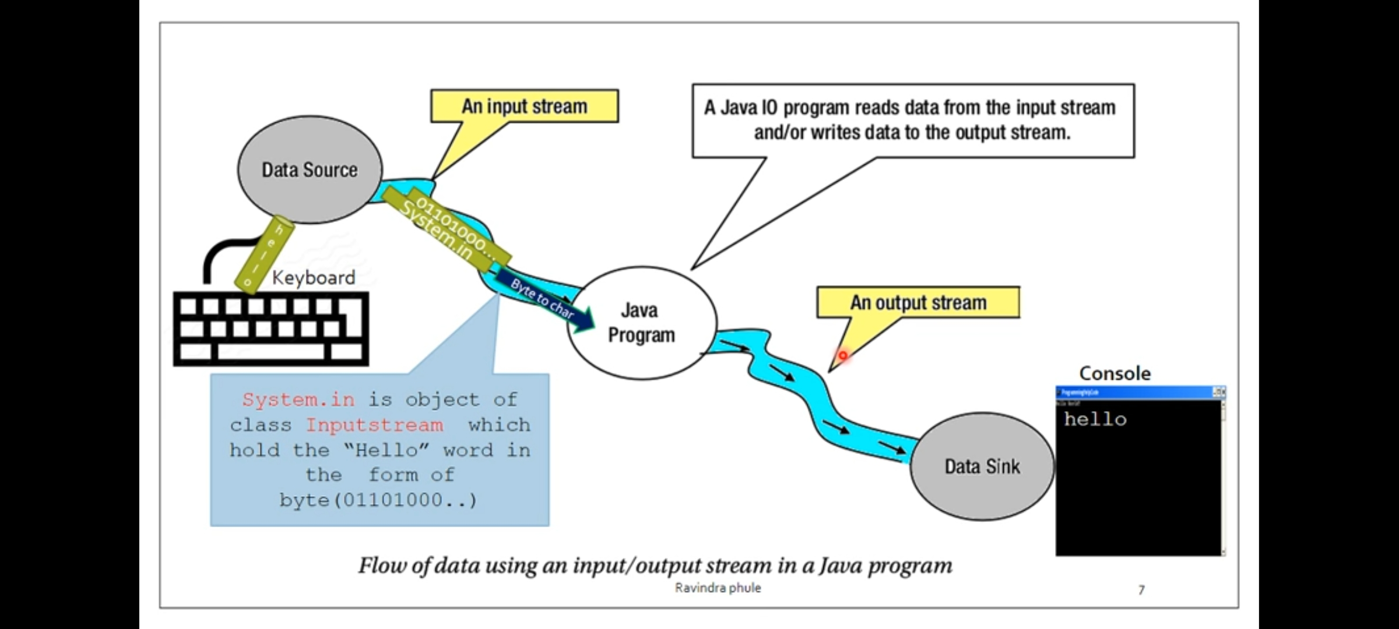
Stream

Slide 11
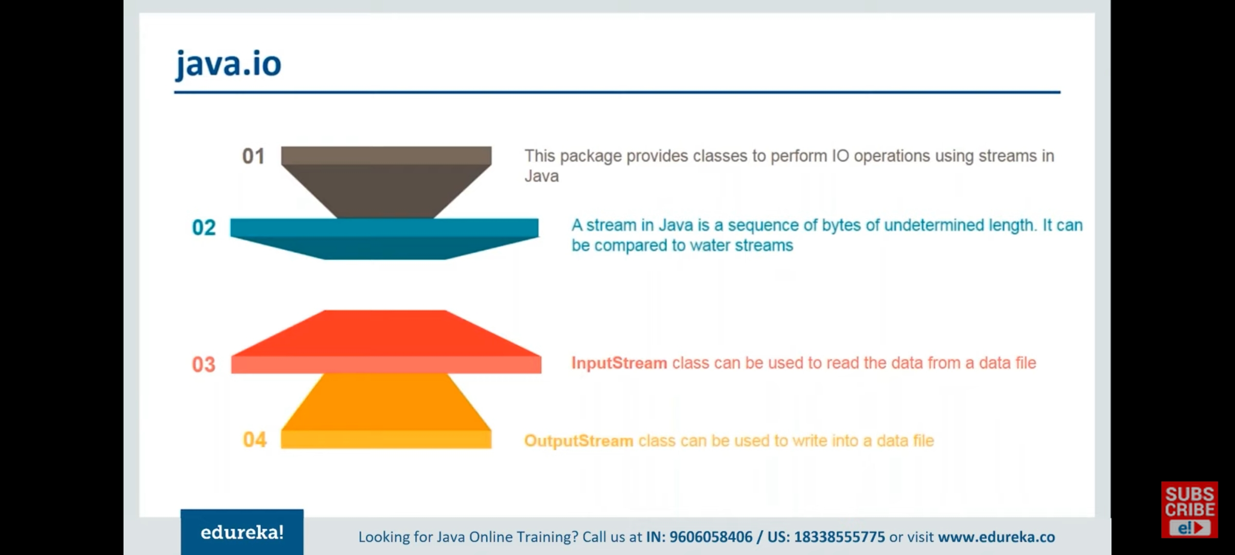
Java IO Stream

Slide 12
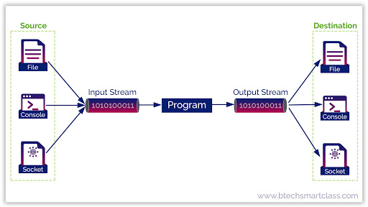
Java IO Stream

Slide 13
Streams
Streams in JAVA are Objects, of course !
Having
2 types of streams (text / binary) and
2 directions (input / output)
results in 4 base-classes dealing with I/O:
Reader: text-input
Writer: text-output
InputStream: byte-input
OutputStream: byte-output

Slide 14
Streams
JAVA distinguishes between 2 types of streams:
Text – streams, containing ‘characters‘
Program
I
‘
M
A
S
T
R
I
N
G
\n
Device
Binary Streams, containing 8 – bit information
Program
01101001
11101101
00000000
Device

Slide 15
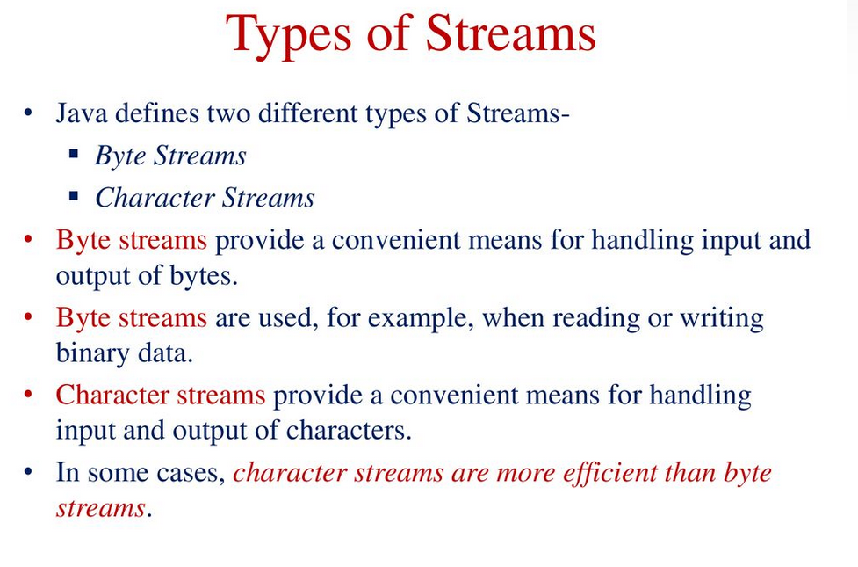

Slide 16
Character vs. Byte Streams
A character stream manages 16-bit Unicode characters
A byte stream manages 8-bit bytes of raw binary data
A program must determine how to interpret and use the bytes in a byte stream
Typically they are used to read and write sounds and images
The InputStream and OutputStream classes (and their descendants) represent byte streams
The Reader and Writer classes (and their descendants) represent character streams

Slide 17
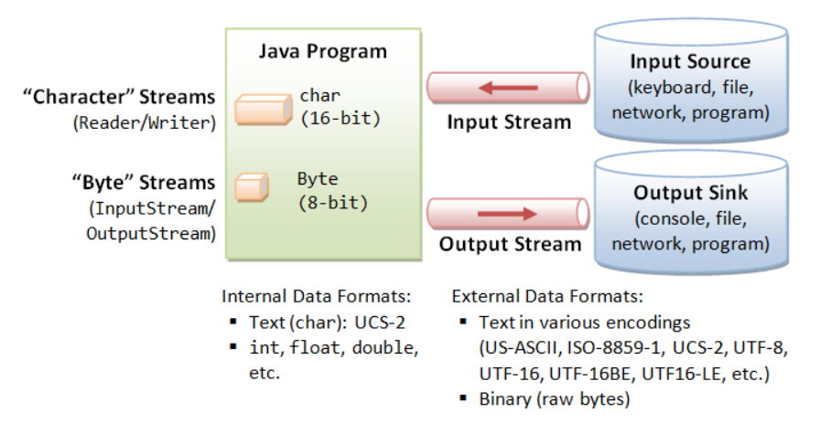
Character vs. Byte Streams

Slide 18
Streams based on data
Byte Stream: used to read or write byte data.
Character Stream: used to read or write character data.

Slide 19
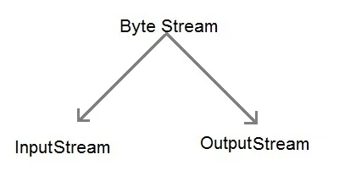
Byte Stream
Byte stream is used to read and write a single byte (8 bits) of data.
All byte stream classes are derived from base abstract classes called
InputStream and OutputStream.
Java InputStream Class
Java OutputStream Class
Character Stream
Character stream is used to read and write a single character of data.
All the character stream classes are derived from base abstract classes Reader and Writer.
Java Reader Class
Java Writer Class

Slide 20
Java IO Stream
The java.io package contains many classes that allow us to define various streams with particular characteristics
Some classes assume that the data consists of characters
Others assume that the data consists of raw bytes of binary information
Streams can be further subdivided as follows:
data stream, which acts as either a source or destination
processing stream, which alters or manipulates the basic data in the stream

Slide 21
Data vs. Processing Streams
A data stream represents a particular source or destination such as a string in memory or a file on disk
A processing stream (also called a filtering stream) manipulates the data in the stream
It may convert the data from one format to another
It may buffer the stream

Slide 22
Data vs. Processing Streams
Data
Streams
Processing
Streams
Input Streams
Output Streams
Character
Streams
Byte
Streams

Slide 23
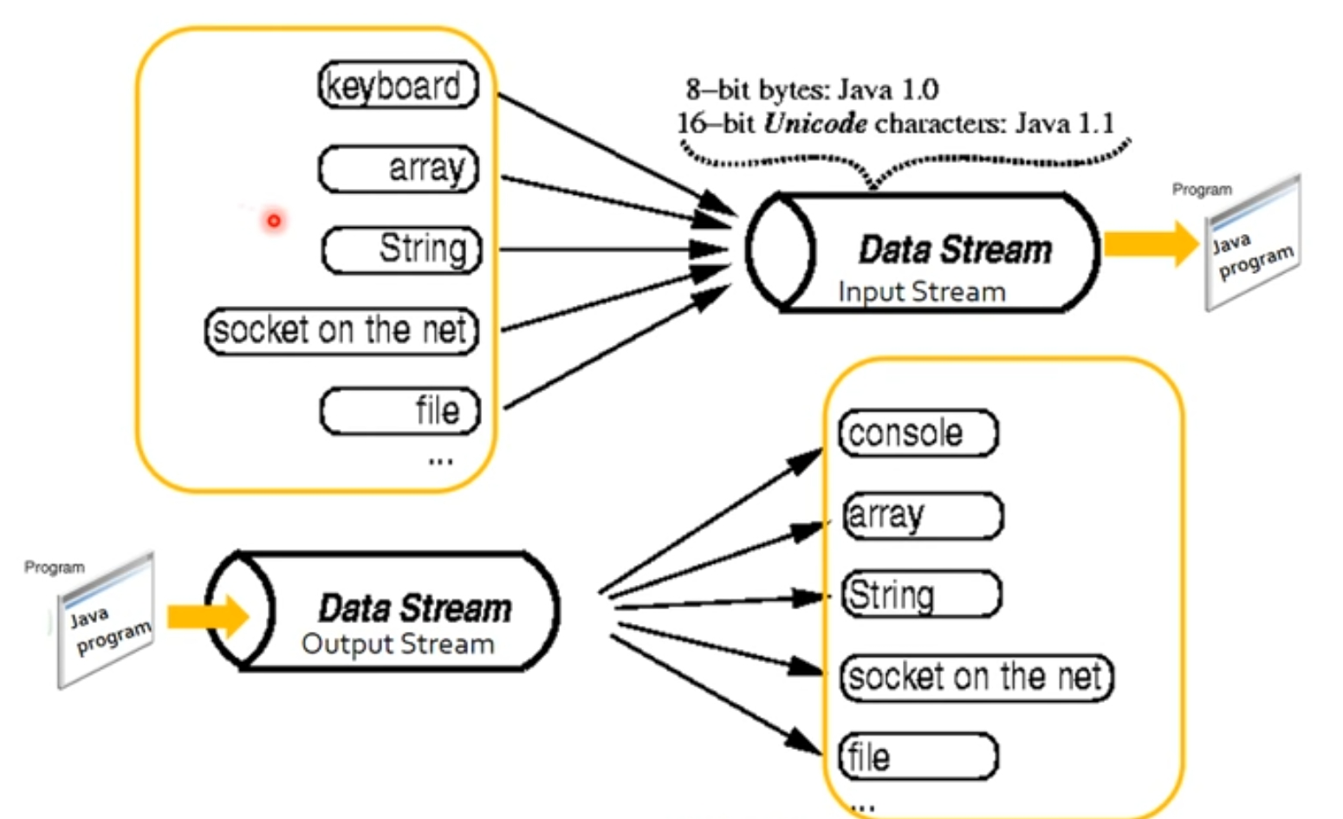
Data vs. Processing Streams

Slide 24
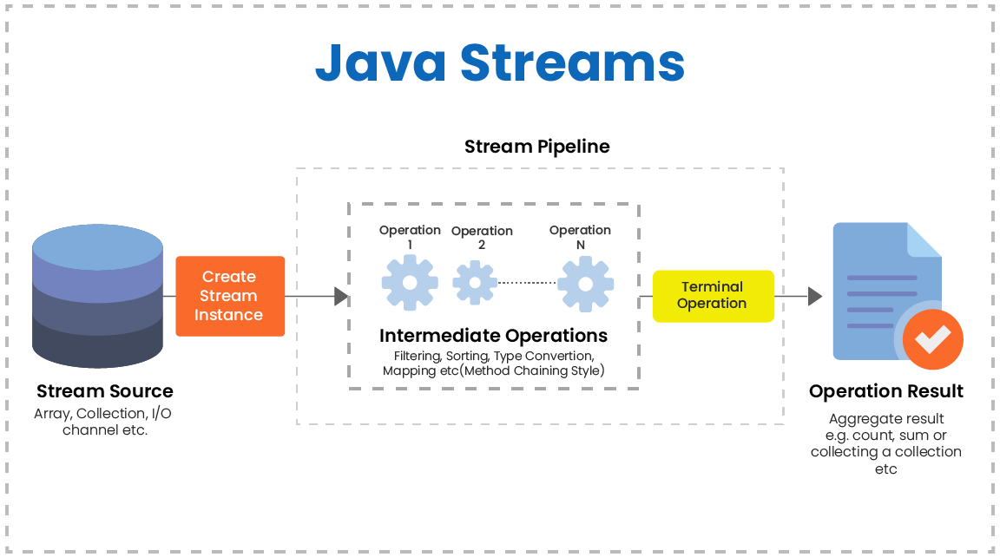
Data vs. Processing Streams

Slide 25
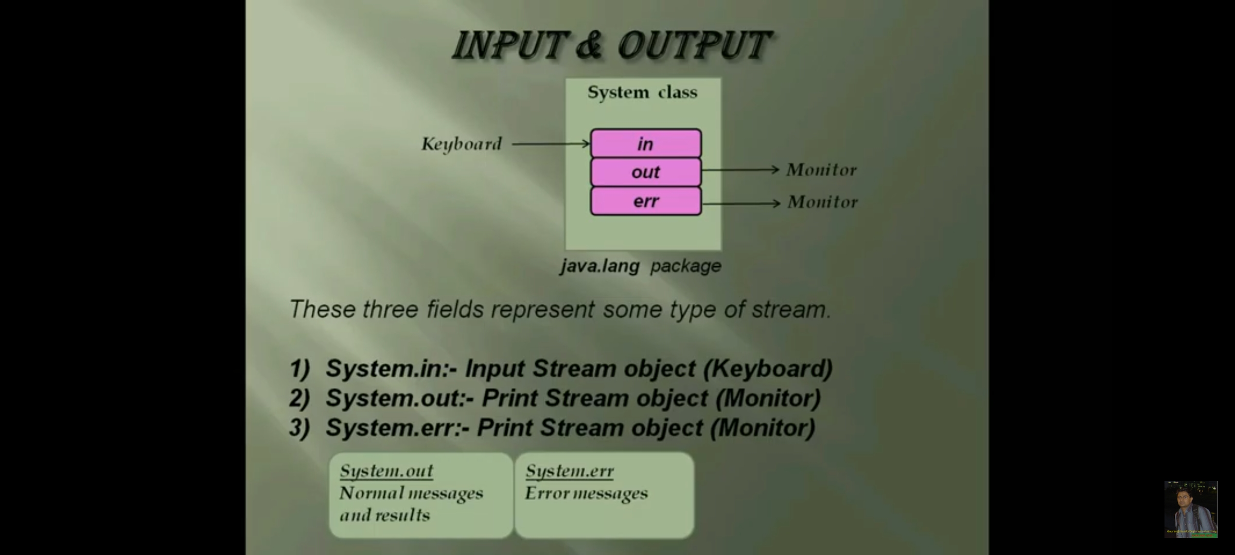
Three types of streams

Slide 26
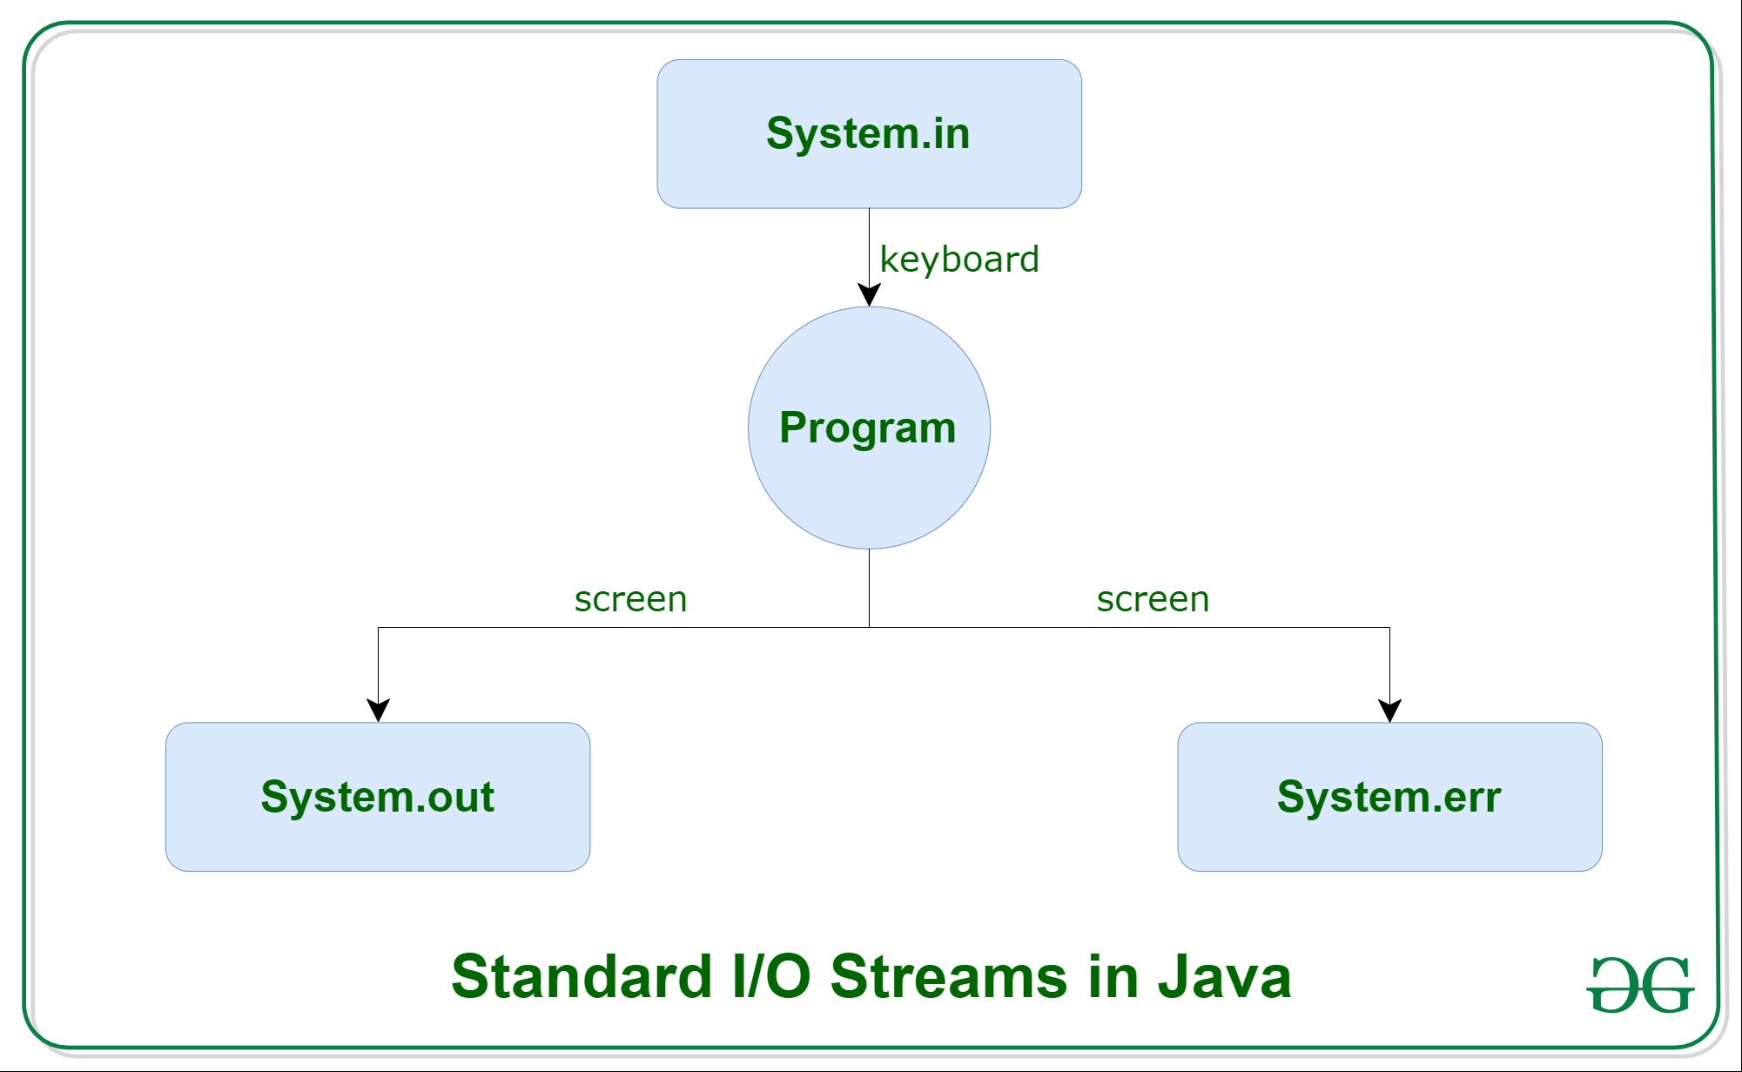
Java IO Stream

Slide 27
Standard I/O
PrintStream objects automatically have print and println methods defined for them
The PrintWriter class is needed for advanced internationalization and error checking

Slide 28
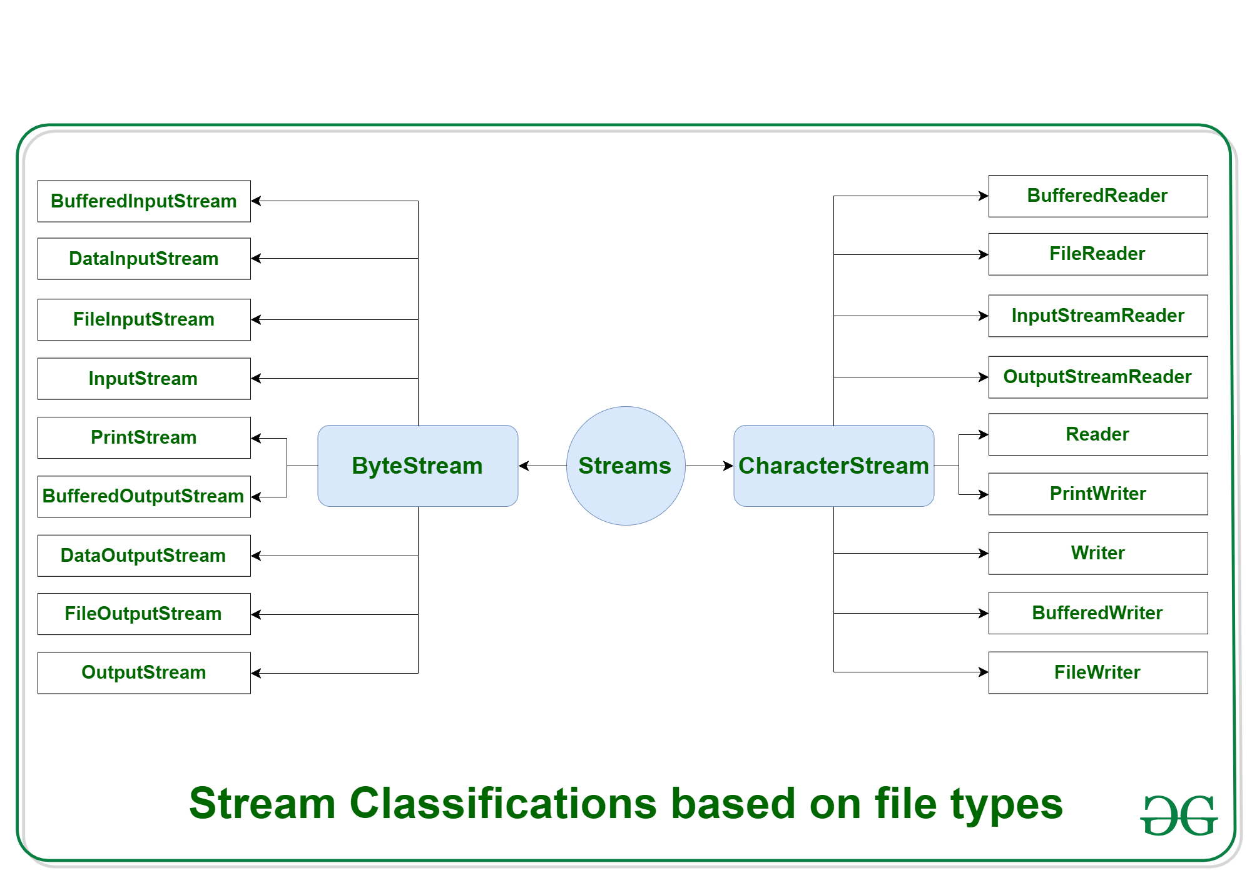

Slide 29
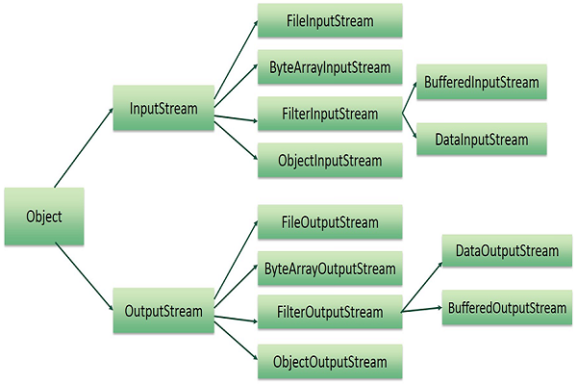

Slide 30
InputStream hierarchy
InputStream
ByteArray File Filter Piped Object Sequence
InputStream InputStream InputStream InputStream InputStream InputStream
Data Buffered LineNumber PushBack
InputStream InputStream InputStream InputStream

Slide 31
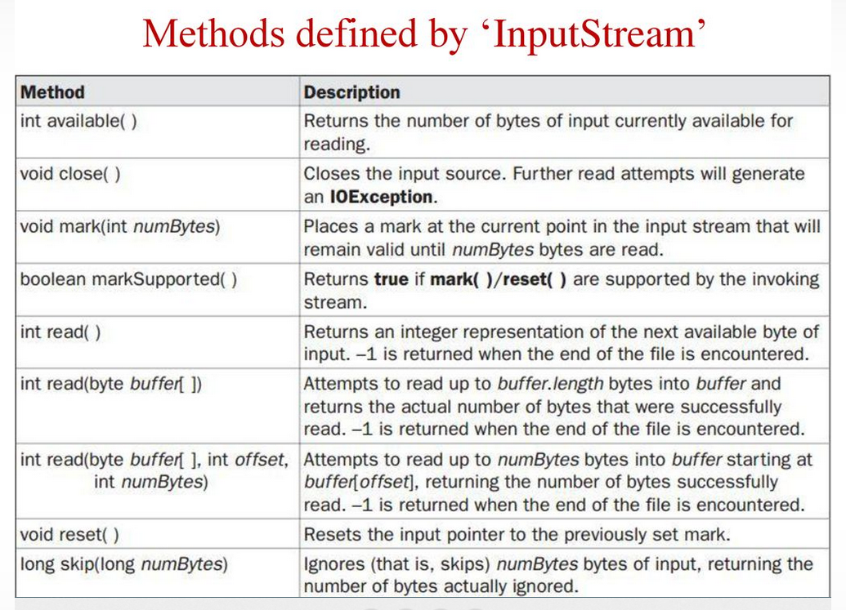

Slide 32
Writing Bytes
void write(int b) - writes a single byte to an output location.
Java IO programs involve using concrete versions of these because most data contain numbers, strings and objects rather than individual bytes

Slide 33
OutputStream hierachy
OutputStream
ByteArray File Filter Piped Object
OutputStream OutputStream OutputStream OutputStream OutputStream
Data Buffered PrintStream
OutputStream OutputStream

Slide 34
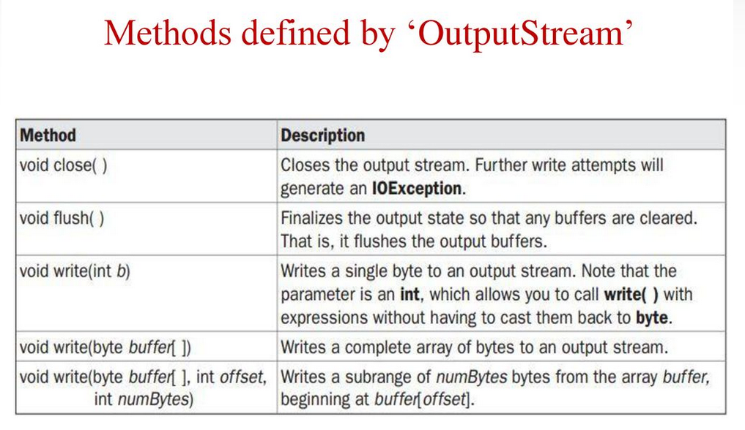

Slide 35
File Processing
Typical pattern for file processing is:
OPEN A FILE
CHECK FILE OPENED
READ/WRITE FROM/TO FILE
CLOSE FILE
Input and Output streams have close method (output may also use flush)

Slide 36
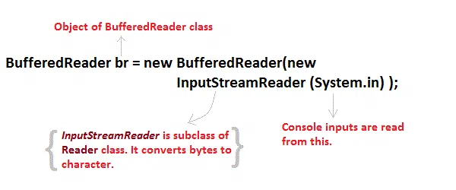
https://www.jbktutorials.com/corejava/input-and-output-streams-in-java.php#gsc.tab=0

Slide 37
Java IO
Java.io package provides classes for system input and output through files, network streams, memory buffers, etc.
Some input-output stream will be initialized automatically by the JVM and these streams are available in System class as in, out, and err variable.
in reference refers to the default input device, i.e. keyboard.
out and err refers to the default output device, i.e. console.

Slide 38
class CharRead
{
public static void main( String args[])
{
BufferedReader br = new Bufferedreader(new InputstreamReader(System.in));
char c = (char)br.read(); //Reading character
}
}

Slide 39
Reading Strings in Java
To read string we have to use readLine() function with BufferedReader class's object.
String readLine() throws IOException

Slide 40
Program to take String input from Keyboard in Java
import java.io.*;
class MyInput
{
public static void main(String[] args)
{
String text;
InputStreamReader isr = new InputStreamReader(System.in);
BufferedReader br = new BufferedReader(isr);
text = br.readLine(); //Reading String
System.out.println(text);
}
}

Slide 41
Program to read from a file using BufferedReader class
import java. Io *;
class ReadTest
{
public static void main(String[] args)
{
try
{
File fl = new File("d:/myfile.txt");
BufferedReader br = new BufferedReader(new FileReader(fl)) ;
String str;
while ((str=br.readLine())!=null)
{
System.out.println(str);
}
br.close();
fl.close();
}
catch(IOException e) {
e.printStackTrace();
}
}
}

Slide 42
Program to write to a File using FileWriter class
import java. Io *;
class WriteTest
{
public static void main(String[] args)
{
try
{
File fl = new File("d:/myfile.txt");
String str="Write this string to my file";
FileWriter fw = new FileWriter(fl) ;
fw.write(str);
fw.close();
fl.close();
}
catch (IOException e)
{ e.printStackTrace(); }
}
}

Slide 43
File IO Streams
FileInputStream and FileOutputStream give you IO from a disk file
FileInputStream fin = new FileInputStream(“in.txt”);
We can now read bytes from a file but not much else! To get a file stream that can process data means combining two streams into a filtered stream (here using DataInputStream):
FileInputStream fin = new FileInputStream(“in.txt”);
DataInputStream din = new DataInputStream(fin);
double s = din.readDouble(); // better interface to file!

Slide 44
Buffering
By default streams are not buffered, so every read or write results in a call to the OS (= very slow!).
Adding buffering means chaining streams:
DataInputStream din =
new DataInputStream(
new BufferedInputStream(
new FileInputStream(“in.txt”)));
DataInputStream is last in the chain here because we want to use its methods and we want them to use the buffered methods (eg read).

Slide 45
File I/O Streams Constructors
FileInputStream(String name)
FileOutputStream(String name)
BufferedInputStream(InputStream in)
BufferedOutputStream(OutputStream out)

Slide 46
Random Access Streams
Files are normally processed from start to end but this can be time consuming (recall that streams are sequences of bytes). To find (or write) data anywhere in a file we can use a RandomAccessFile stream class.
RandomAccessFile in = new RandomAccessFile(“in.dat”,”r”);
RandomAccessFile out = new RandomAccessFile(“out.dat”,”rw”);
A useful method is “seek(long pos)” that allows you to move the file pointer to a byte position in the file and start reading from their.

Slide 47
Text Streams
Character IO is done using subclasses of the abstract classes Reader and Writer. To write text we use the PrintWriter class:
Example:
PrintWriter out = new PrintWriter(
new FileWriter(“out.txt”));
String name = “Fred Jones”;
double score = 240.5;
out.print(name); out.print(‘ ‘);
out.println(score); // writes Fred Jones 240.5

Slide 48
Reading Text
To write data in binary format we use DataOutputStream
To write data in text format we use PrintWriter
Is there a DataInputStream that lets you read in data as text? Sadly, the answer is NO!
Text input is done using a BufferedReader:
BufferedReader in = new BufferedReader(new FileReader(“in.txt”));
String s;
while ((s = in.readLine() ) != null) {
do something with s;
}

Slide 49
Putting Streams to Use
We will look at a standard file processing example using arrays of records (“Scores”):
First as a file of text records:
Chris Harris, 135, India
public void writeScores(PrintWriter os) throws IOException { os.println(name + ‘,’ + highScore + “,” + country);
}

Slide 50
Reading back the scores
We use the BufferedReader (readLine) combination to get the output back in:
BufferedReader in = new BufferedReader(new FileReader(“scores.dat”));
public void readScores(BufferedReader is) throws IOException {
String s = is.readLine( ); // need to break up line!
}
If we had a class called Scores then we could add the writeScores and
readScores methods to its definition.

Slide 51
Example Program 1 DataFileTest
Breaking up lines is done with a Stream Tokenizer which will be dealt with later.
Define class Scores (object holding data to be read or written)
The object writes/reads itself
Create an array of objects and have them individually read/write themselves

Slide 52
Object Streams
So far we have dealt with fixed length records, what if we treat the classes as objects and write them all to disk.
To save object data we need to open an ObjectOutputStream object:
ObjectOutputStream out = new ObjectOutputStream(new FileOutputStream(“scores.dat”));
Now saving objects is easier using writeObject and readObject.

Slide 53
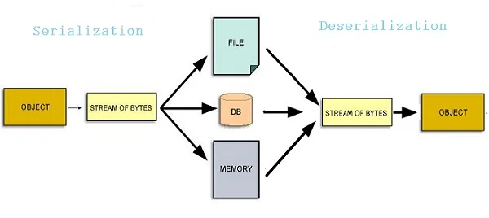

Slide 54
Example 2 - ObjectFileTest
The previous code can be simplified if we rewrite it using object streams – now the array of records can be written/read in one single operation
Note: we have to make the Scores class implement the Serializable interface.
The serialization file format is more expensive than the text format.

Slide 55
Serialization is smart
Consider
class Employee {
String name;
Double salary;
}
Class Manager extends Employee {
private Employee secretary;
// do super trick on manager constructor to init
}

Slide 56
The IOException Class
Operations performed by the I/O classes may throw an IOException
A file intended for reading or writing might not exist
Even if the file exists, a program may not be able to find it
The file might not contain the kind of data we expect
An IOException is a checked exception

